Slide 1
NAKUJA PROJECT
WEEK 2 PRESENTATION
AIRFRAME
1ST FEBRUARY 2023

Slide 2
Past week’s objectives
Preliminary research on the following listed topics:
Research on the material to fabricate the airframe.
Feasibility of Aluminum in fabrication of the airframe.
Research on the material to be used for fabrication. Settled for Aluminium grade 6061.
Dual parachute deployment
Research on launchpad and launch lug designs.

Slide 3
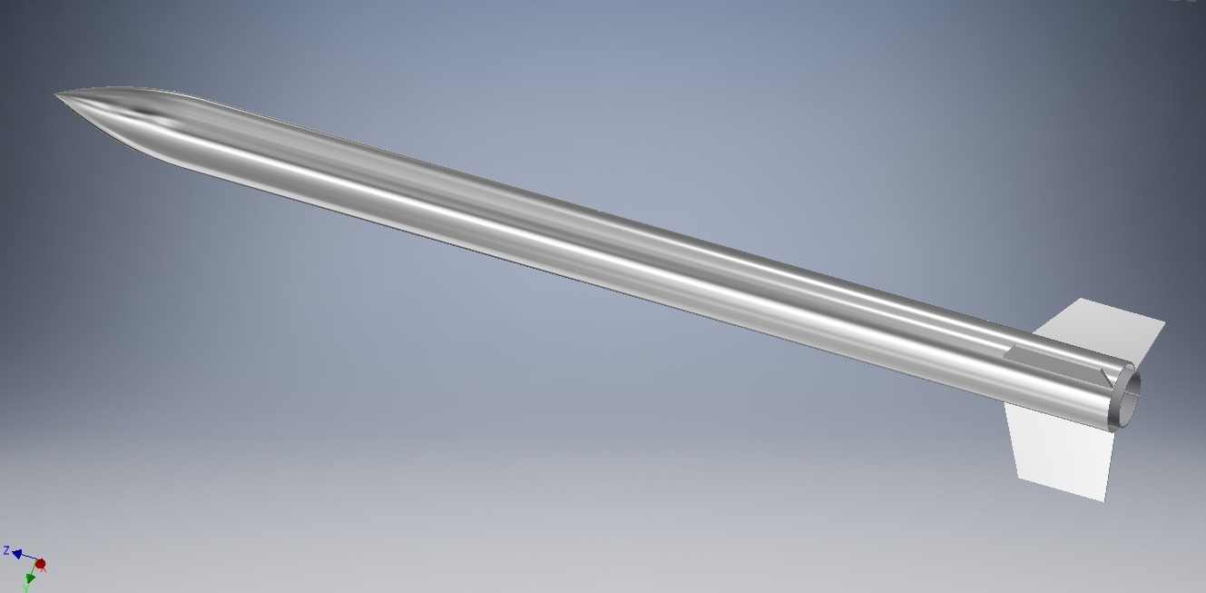
Design examples
Fully assembled airframe with nose cone, body tube and tail.

Slide 4
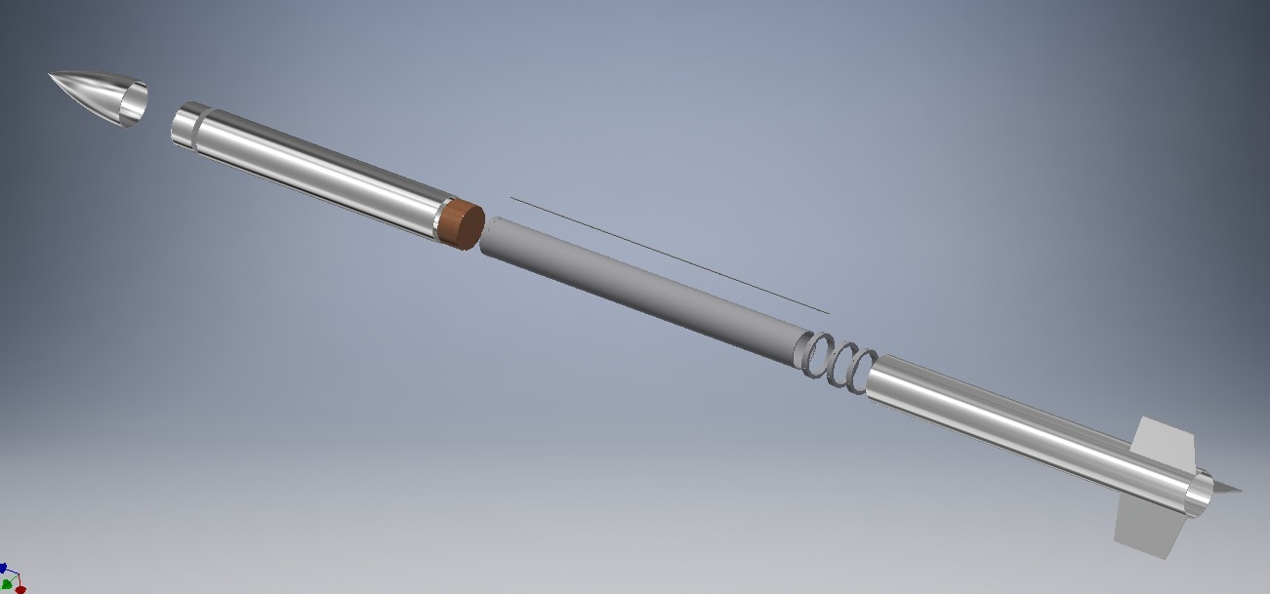
Design examples
Exploded view of the airframe with nose cone, body tube and tail.

Slide 5
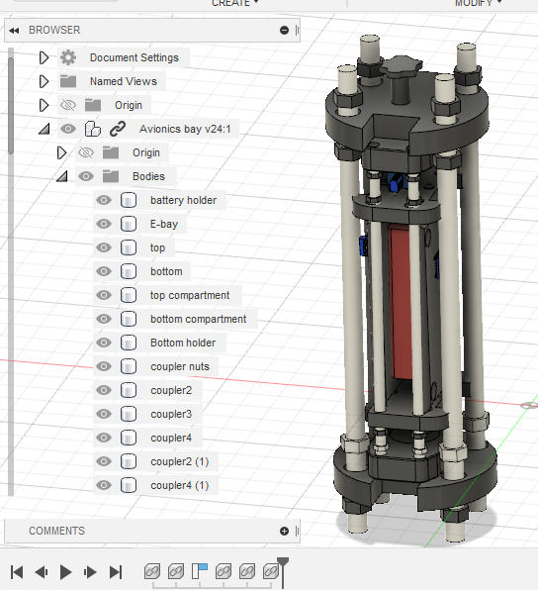
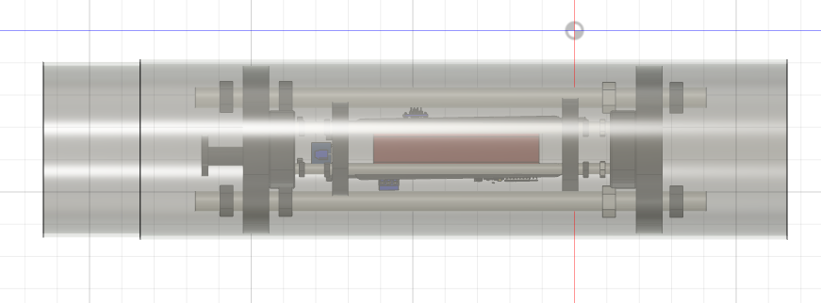
Avionics bay assembly. - Avionics bay inside body tube

Slide 6
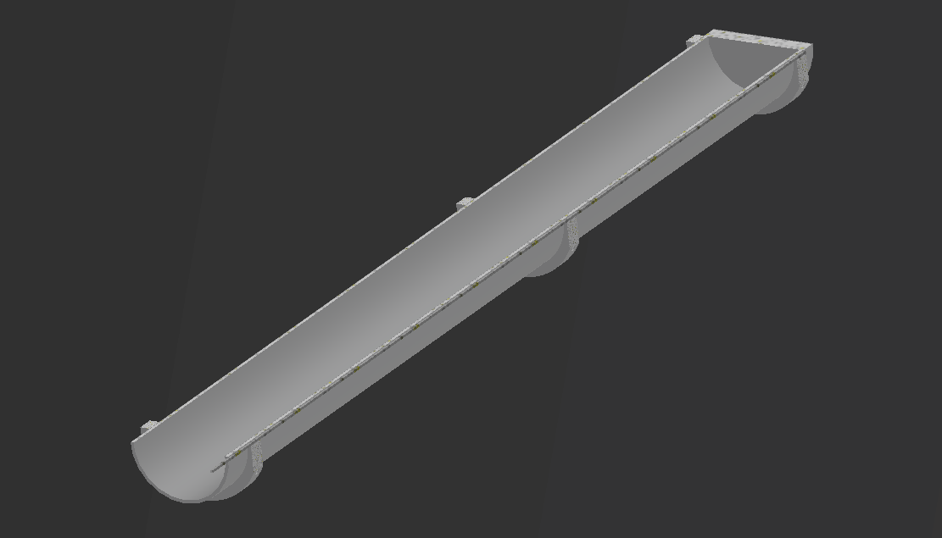
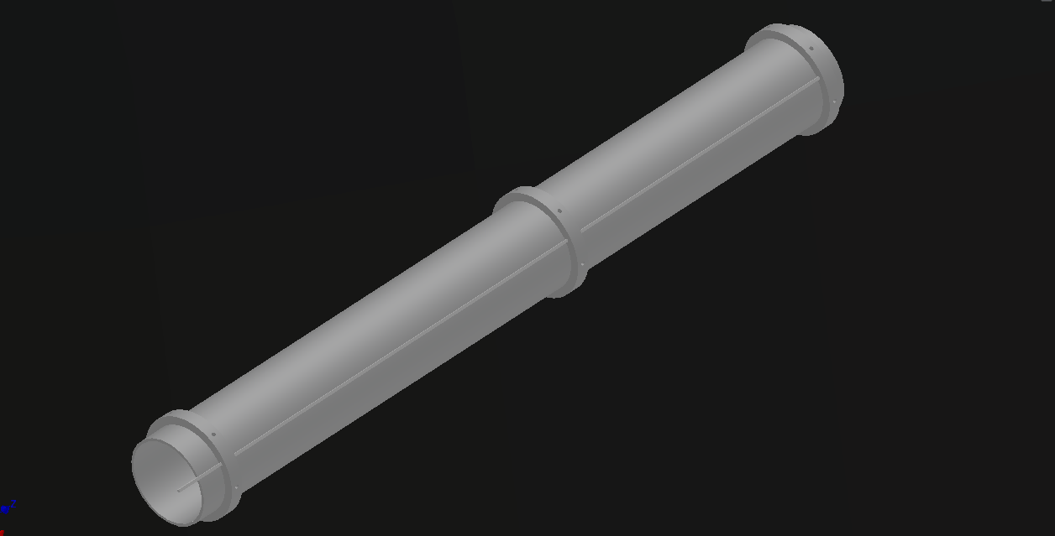
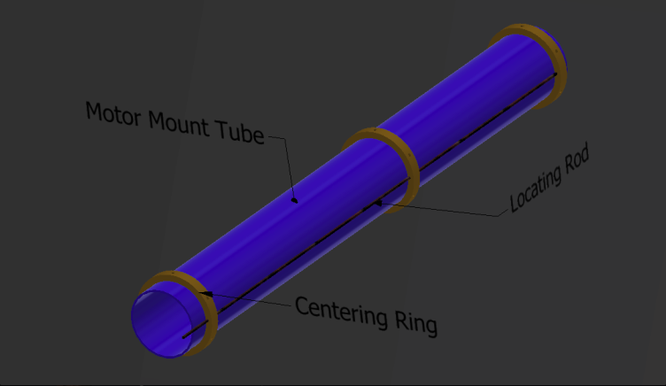
Exploded and assembled view of the motor mount.

Slide 7
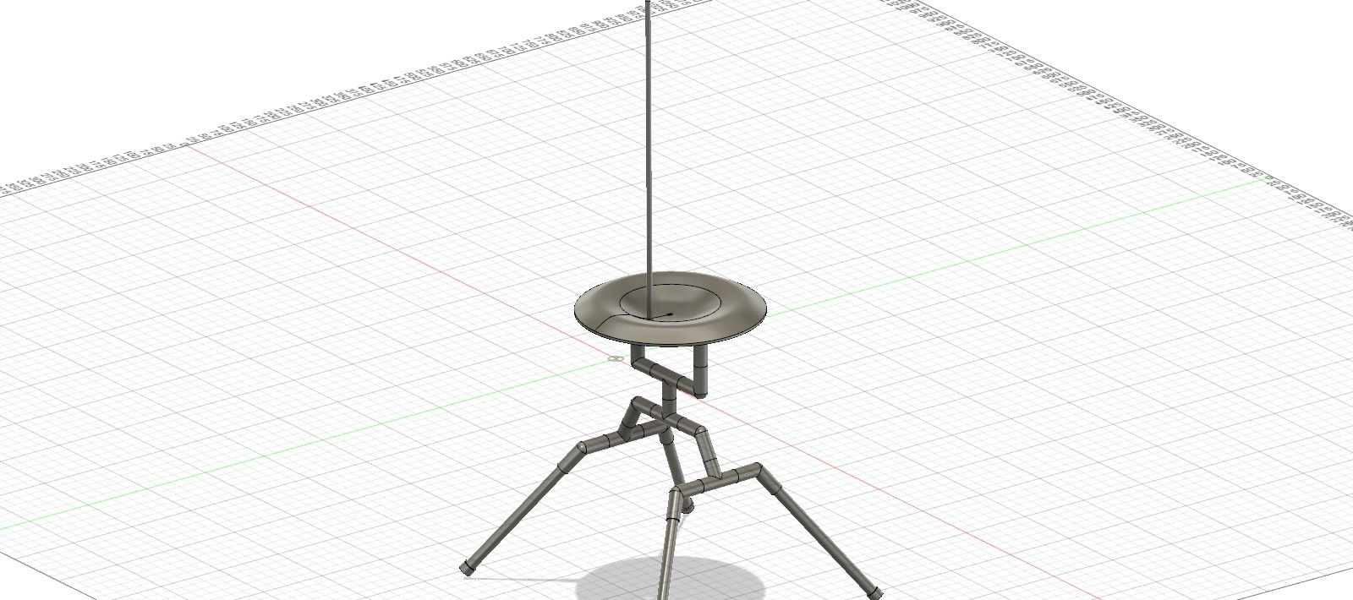
Assembled design of the launch pad and launch rod

Slide 8
Tasklist Spreadsheet
Link to our Excell tasklist:
https://docs.google.com/spreadsheets/d/1M_BzmsQo8DNNqcfr_GzHXy1NbRIfWbWbaoDP3lDmqlY/edit#gid=1232676584
Link to Comprehensive Gantt Chart:
Airframe ProjectSchedule (sharepoint.com)
Link to simplified Gantt Chart:
Simplified Airframe Gantt Chart.xlsx (sharepoint.com)

Slide 9
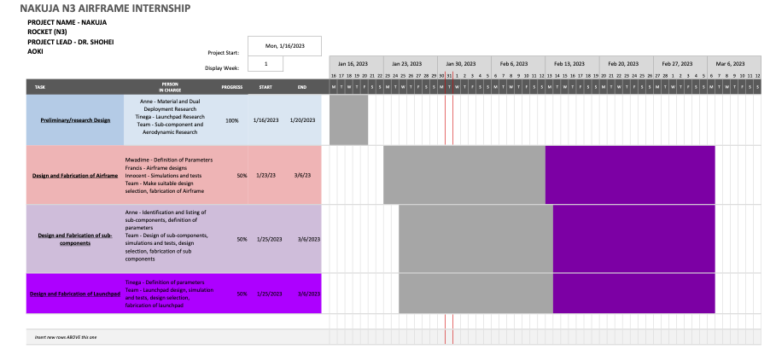
Simplified Airframe Gantt chart

Slide 10
Way forward
Fabricate 5 airframe prototypes
: 3 with fibreglass
; 2 with Aluminium
One of the fins will be fabricated using carbon fibre
We are planning to use the aluminum rod instead of sheet for accuracy and ease of fabrication.

Slide 11
This week’s objectives
Research and selection of fabrication techniques
Settle on parameter selection
Generation of bill of materials
Finalise on designs
Make design selection

